Slide 1
Customer Retention Project

Slide 2
Problem Statement
There was collection of the customer details from an online Indian shopping stores.
This Dataset gives us information on
1-Knowing the customer-(1-17Columns)
2-How is the customer feeling(18-47 columns)-ratings of the customer
What are the things which are going good for the customer to the satisfaction for the customer, So that the customer returns to the same Shopping store- Maintaining High Retention
What are the factors that the customer is not very Happy about and would make the customer explore alternative online store. Which would reduce our customer retention percentage.

Slide 3
Exploratory Data Analysis
I would mainly divide this data study into 3 parts
Understand what is in the Data set, which is important to make a valid conclusion for the client?
Understand who are the customers who are actually rating system?
What are the factors which are unto customer satisfaction, and which are factors which need improvements?

Slide 4
Step-1 Understand what is in the Data set, which is important to make a valid conclusion for the client?
The Shape of the Dataset is with (269 Rows , 71 columns)
There are no missing data in the data set
The first 47 columns look unique and are made used for understanding the results for my problem statement
The Columns is yellow shows Knowing the customer
The columns in blue shows how the customer feel
Column Non-Null Count Dtype
--- ------ -------------- -----
0 Gender 269 non-null object
1 Age 269 non-null object
2 city 269 non-null object
3 Pin Code 269 non-null int64
4 Shopping_time 269 non-null object
5 online_purchase_1year? 269 non-null object
6 access_internet 269 non-null object
7 device_used 269 non-null object
8 screen size 269 non-null object
9 operating_system 269 non-null object
10 browser_run 269 non-null object
11 channel_to_favorite_online_1sttime 269 non-null object
12 reach_online_retailstore 269 non-null object
13 time_explored 269 non-null object
14 preferred_payment 269 non-null object
15 abandon_shoppingcart 269 non-null object
16 Why_abandon_Shoppingcart 269 non-null object
17 content_read/understand 269 non-null int64
18 highlighted_simila_product 269 non-null int64
19 Full_info_listed_seller 269 non-null int64
20 relevant_info_listed 269 non-null int64
21 Ease_navigation 269 non-null int64
22 Loading_processing_speed 269 non-null int64
23 User_friendly_Interface 269 non-null int64
24 Convenient_Payment_methods 269 non-null int64
25 Trust_transaction_time 269 non-null int64
26 Empathy_customers 269 non-null int64
27 guarantee_privacy 269 non-null int64
28 availability_to_communication 269 non-null int64
29 monetary_benefit/discounts 269 non-null int64
30 Enjoyment 269 non-null int64
31 convenient_flexible 269 non-null int64
32 Return_replacement 269 non-null int64
33 access_loyalty_programs 269 non-null int64
34 quality_Info 269 non-null int64
35 quality_website/application 269 non-null int64
36 Net_Benefit 269 non-null int64
37 trust 269 non-null int64
38 wide_variety_several cato 269 non-null int64
39 Provision_product_info 269 non-null int64
40 Monetary_saving 269 non-null int64
41 Convenience_of_patronizing 269 non-null int64
42 sense_of_adventure 269 non-null int64
43 e-tailer_social_status 269 non-null int64
44 gratification_favorite_e-tailer 269 non-null int64
45 fulfill_certain_roles 269 non-null int64
46 value_money_spent 269 non-null int64

Slide 5
Checking If there is correlation in the customer information usage attributes
feature VIF
0 Gender 2.380810
1 Age 3.195411
2 city 4.432167
3 Pin Code 4.737475
4 Shopping_time 6.490132
5 online_purchase_1year? 6.208568
6 access_internet 12.244036
7 device_used 23.272303
8 screen size 12.875337
9 operating_system 13.915329
10 browser_run 2.756840
11 channel_to_favorite_online_1sttime 25.370537
12 reach_online_retailstore 5.084016
13 time_explored 9.346267
14 preferred_payment 3.955808
15 abandon_shoppingcart 14.557049
16 Why_abandon_Shoppingcart 5.137324
The information here tells that Gender , Age, City, Pin Code , Shopping time, online purchase done in 1 year, reached online retail stores ,browser run time, Preferred payment Why abandon shopping cart are all independent variables
access internet , device used , screen size, operating system , channel_to_favorite_online_1sttime, time explored, abandon_shopping cart are all correlated variables to one other lets see what is the correlation are depended

Slide 6
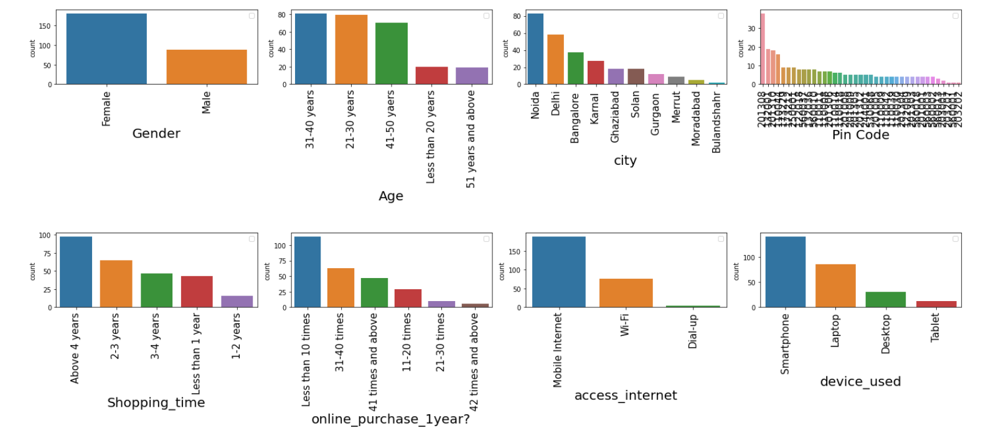
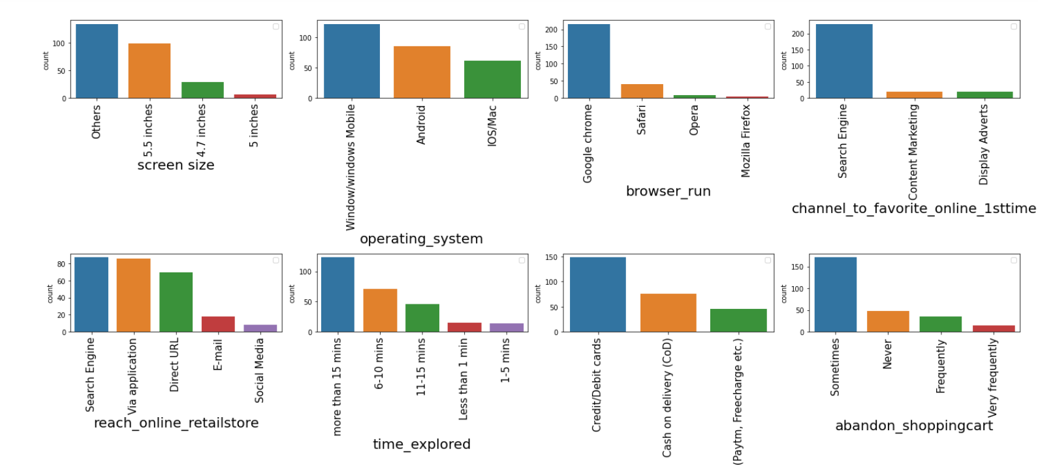
2-Let's understand all the variables-Independent variables
2 STEP-Understand who are the customers who are actually rating system?
The shopping is more prevent by Female then male
The shopping is less by people less the 20 yrs. and more the 50 yrs. of aged people
More prominent in metro cites like Delhi, Noida, Bangalore then in small cities
Old customers are still the people who use online more
Online Purchase is around 10 times in a year
The browsing window is mainly Chrome
The Favorite online means by search Engine
The cart is abandoned only sometime for most of the customers

Slide 7
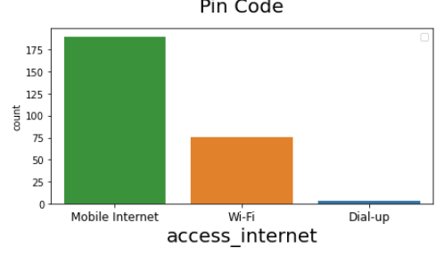
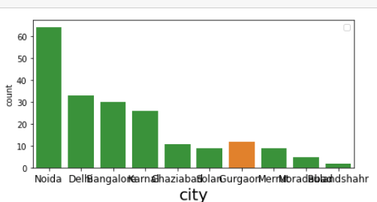
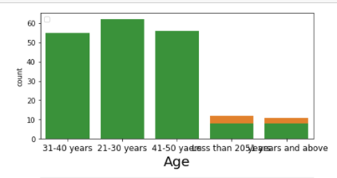
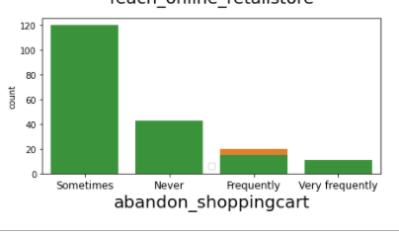
Let's understand all the variables-dependent Variables variables-access internet variable
WiFi is more in Gurgaon and more in less then 20 and more the 50 aged people
Abandon of the cart is frequent when WiFi is used compared to others

Slide 8
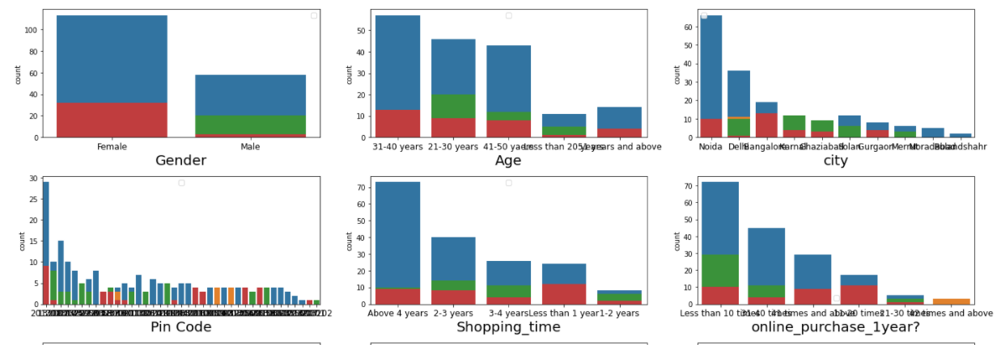
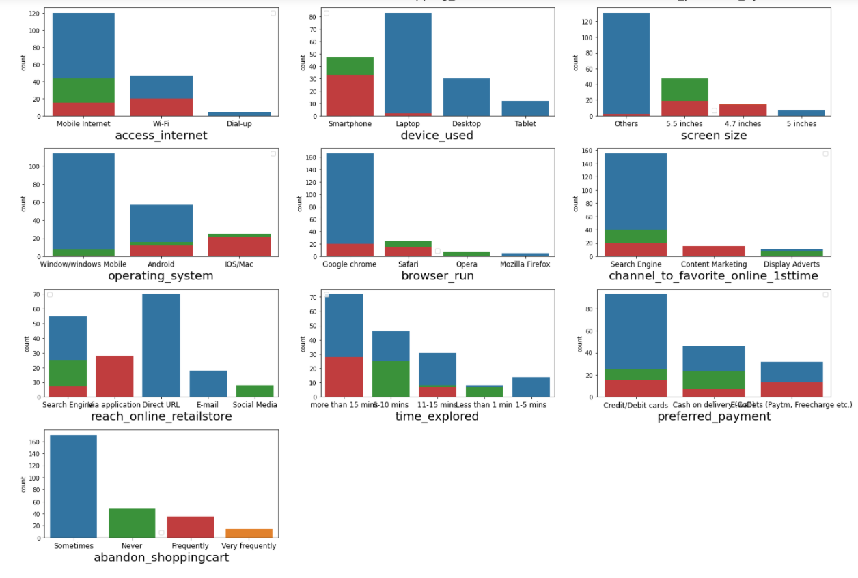
Let's understand all the variables-dependent Variables abandon shopping cart variable
Abandon more frequently by Female
Abandon more frequently by new customers who are less then 1 yr ols to the site
More when bowed on Smart Phone
More frequent when the browsing time is more than 15 mins
Its more on Mac operating system

Slide 9
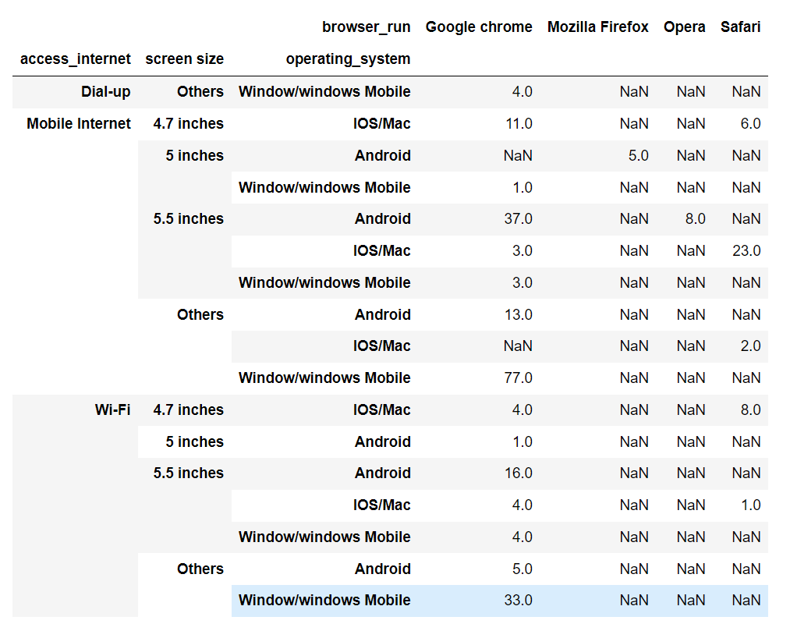
To understand how this data is build the pivot and group by data was done and understood
Any operating system so any screen size, its mostly chrome which is been used

Slide 10
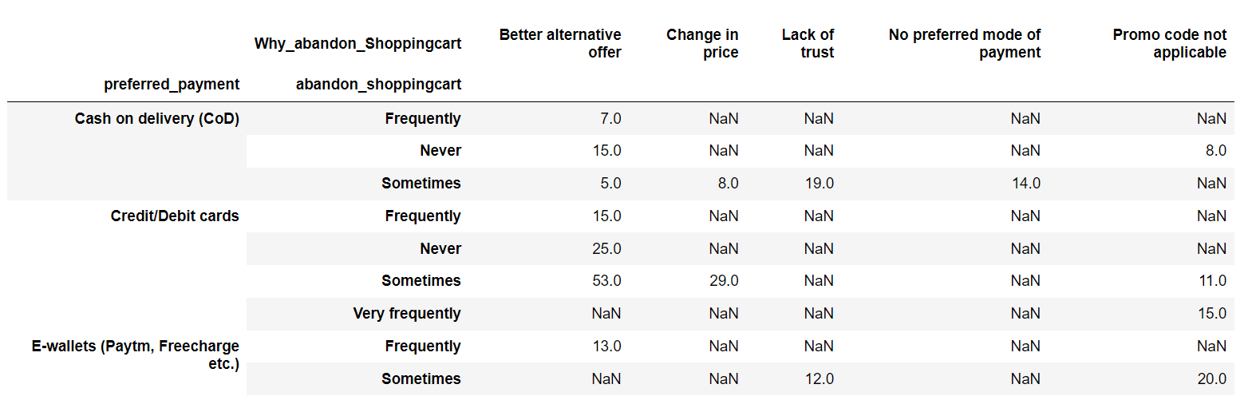
The cart is mostly rejected because there have found better alternative offer
Next goes that the promo code is not applicable

Slide 11
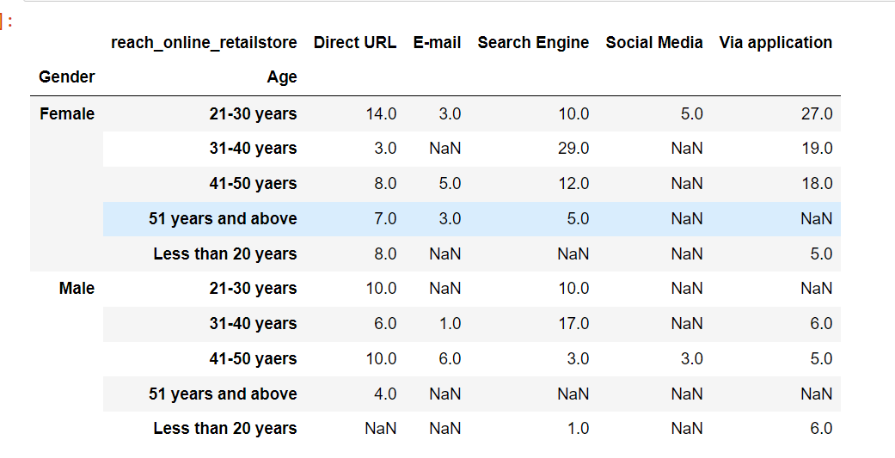
Usually, they reach online retail store by direct URL and then via application

Slide 12
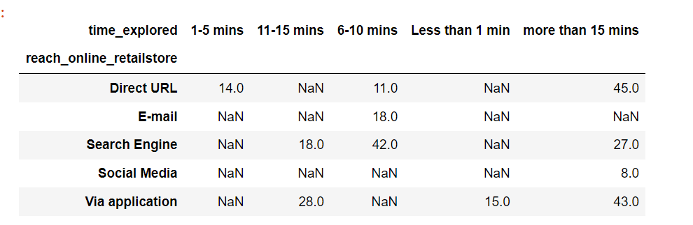
Usually, the browser time is more then 15 mins if it is by Direct URL and via application Takes 6-10 mins by search Engine it can be less then 1 min if its by application

Slide 13
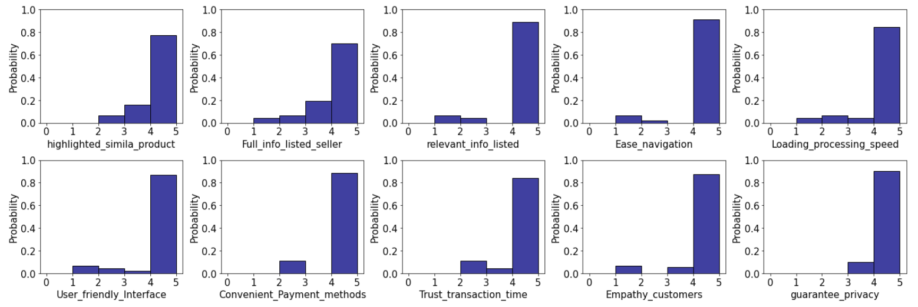
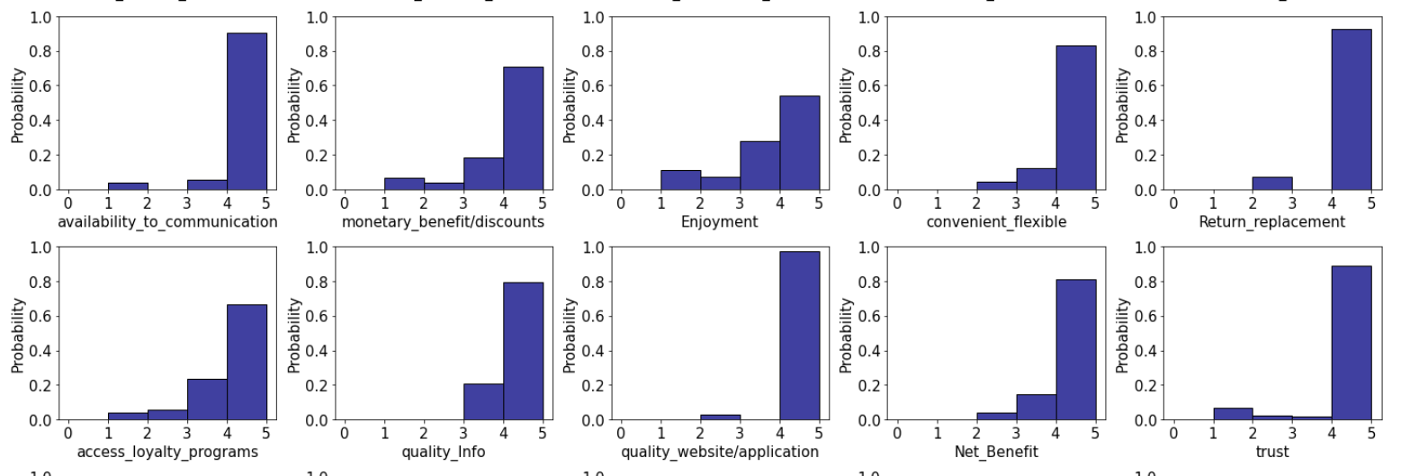
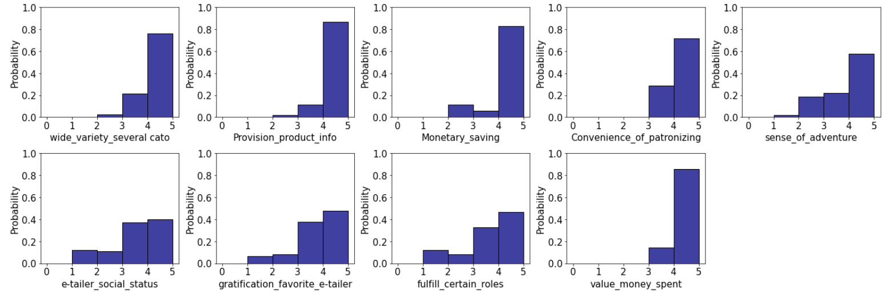
Customer Feedback Analysis

Slide 14
Conclusions
The Data Application should be concentrating on having 18 The content on the website must be easy to read and understand', '19 Information on similar product to the one highlighted is important for product comparison', '20 Complete information on listed seller and product being offered is important for purchase decision.', '21 All relevant information on listed products must be stated clearly', '22 Ease of navigation in website', '23 Loading and processing speed', '24 User friendly Interface of the website', '25 Convenient Payment methods', '26 Trust that the online retail store will fulfill its part of the transaction at the stipulated time', '27 Empathy (readiness to assist with queries) towards the customers', '28 Being able to guarantee the privacy of the customer', '29 Responsiveness, availability of several communication channels (email, online rep, twitter, phone etc.)', '30 Online shopping gives monetary benefit and discounts', Need Improvement-31 Enjoyment is derived from shopping online' '32 Shopping online is convenient and flexible', '33 Return and replacement policy of the e-tailer is important for purchase decision', Need Improvement- 34 Gaining access to loyalty programs is a benefit of shopping online', '35 Displaying quality Information on the website improves satisfaction of customers', Best Part -36 User derive satisfaction while shopping on a good quality website or application' '37 Net Benefit derived from shopping online can lead to users satisfaction', '38 User satisfaction cannot exist without trust', '39 Offering a wide variety of listed product in several category', '40 Provision of complete and relevant product information', '41 Monetary savings', '42 The Convenience of patronizing the online retailer', Need Improvement-43 Shopping on the website gives you the sense of adventure', Need Improvement-44 Shopping on your preferred e-tailer enhances your social status', Need Improvement- 45 You feel gratification shopping on your favorite e-tailer', Need Improvement- 46 Shopping on the website helps you fulfill certain roles', '47 Getting value for money spent',

Slide 15
Conclusion For the customers distribution is included for every slide

Slide 16
THANK YOU

